Slide 1

Introduction to Python
September 13, 2020
Mike Babb, Ph.C.
Center for Social Science Computation and Research
Department of Geography, UW

Slide 2
Location of this tutorial and workshop material
https://github.com/mike-babb/intro_to_python

Slide 3
Why python?
It’s easy to jump in: https://www.python.org/about/gettingstarted/
It’s cross-platform: Windows, Mac, Linux
It was designed to be simple and readable: https://xkcd.com/353/
It’s free and open source
It’s popular: https://www.tiobe.com/tiobe-index/python/
It’s prolific: used in many industries for many jobs. Finance, real estate tech, server administration, health care research, non-profit administration
And departments across campus: sociology, economics, civil engineering, astronomy (and geography!)
Many libraries that do pretty much what you want with just a few commands

Slide 4
About Python
Developed by Guido van Rossum in the early 90s. Current versions: Python 3.7.x and Python 2.7.x
Python 3.7.x is van Rossum’s (and the larger community’s) attempt at fixing some core issues with python 2.x
Integer division returns floats (5 / 2 = 2.5 instead of 5/2 = 2)
Better handling of strings
Better memory management in some cases
It’s a bit faster in general: https://hackernoon.com/which-is-the-fastest-version-of-python-2ae7c61a6b2b

Slide 5
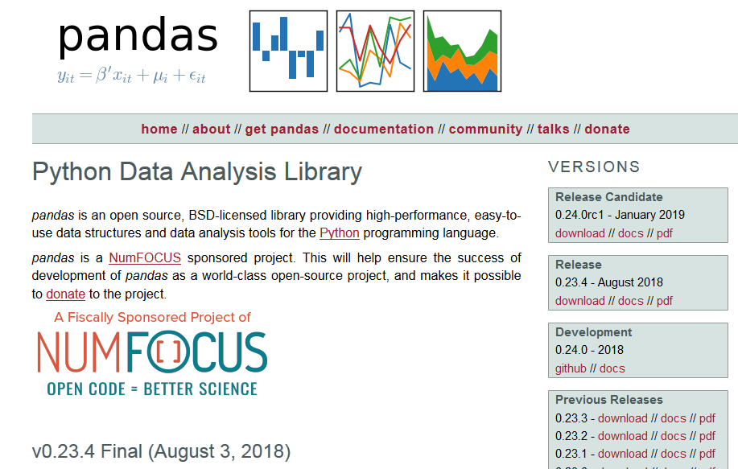
Pandas – Python Data Analysis Library
https://pandas.pydata.org/

Slide 6
Anaconda and the Jupyter Notebook
https://www.anaconda.com/
Available for Mac, Linux, and Windows
THE python data-science platform
Facilitates interactive python
Good for sharing and instruction
Easy to break code into manageable chunks

Slide 7
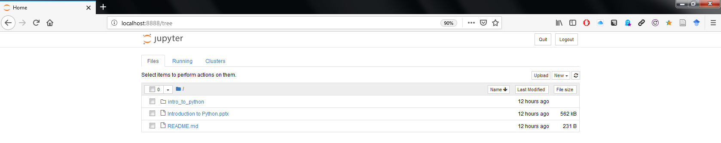
Jupyter Notebook Homepage

Slide 8
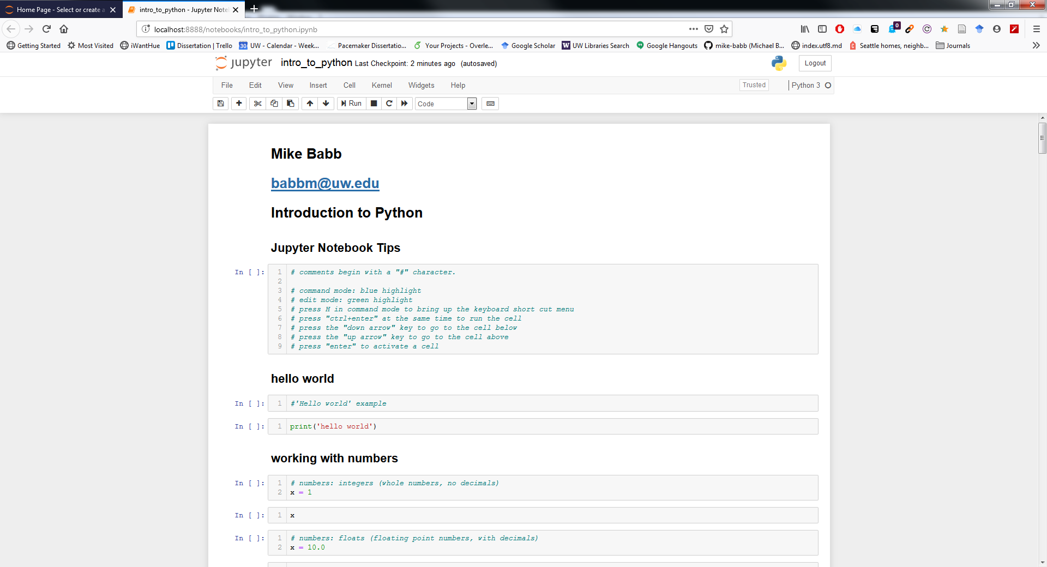
Jupyter Notebook Terminal

Slide 9
Activities
Part 1: Examine basic python syntax
Strings and numbers!
Part 2: Find anagrams
What words can we spell with the letters in the word ‘time’?
Part 3: Construct the all ages sex ratio
Read in data pertaining to the age and sex of the population of Census Designated Places in Washington State during the 2013-2017 time period
Compute the all ages sex-ratio (number of males per 100 females)
Export the data to a .csv and an Excel workbook
Merge the sex-ratio data with a shapefile for mapping in a GIS

Slide 10
Finally… Python or R?
Both
https://github.com/matloff/R-vs.-Python-for-Data-Science

Slide 11
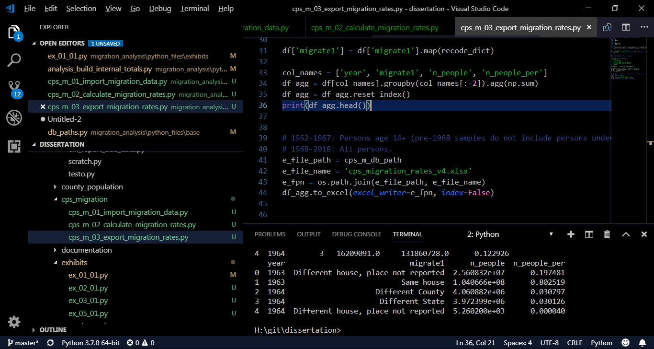
Python in… Visual studio Code
https://code.visualstudio.com/

Slide 12
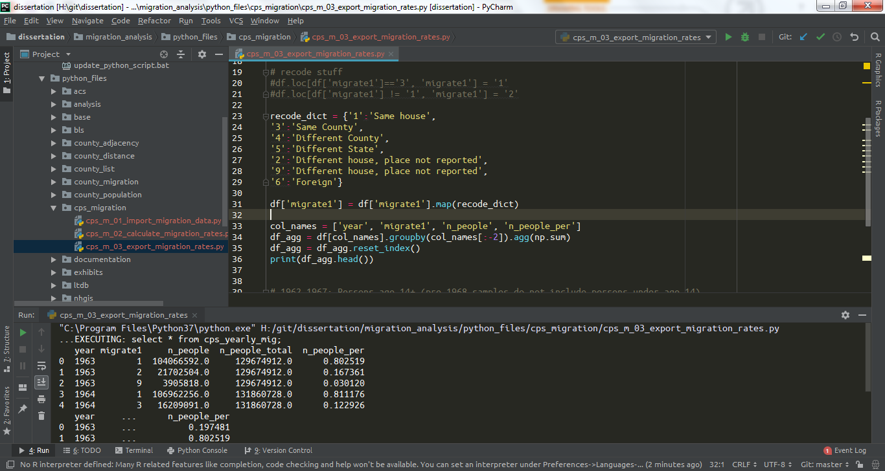
Python in… PyCharm
https://www.jetbrains.com/pycharm/

Slide 13
Additional information on sex ratios
https://www.pnas.org/content/112/16/E2102
https://www.populationpyramid.net/united-states-of-america/2017/
http://science.sciencemag.org/content/297/5589/2008

Slide 14
Data Sources
American Fact Finder
https://factfinder.census.gov/faces/nav/jsf/pages/index.xhtml
Place geography
https://www.census.gov/geo/maps-data/data/tiger.html

